Slide 1

Hackathon 5 – Recommender Systems
December 7th, 2020

Slide 2
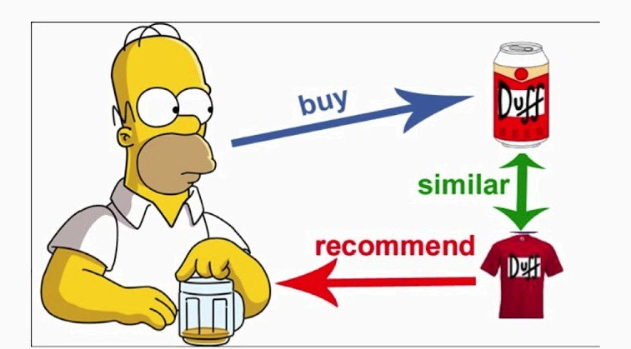
Sonia Seyed Allaei

Slide 3
1. Problem description

Slide 4
Problem description
Simple description of the problem that was given to you to solve.
1 Slide Max!

Slide 5
2. Workflow

Slide 6
2.1 Data preparation

Slide 7
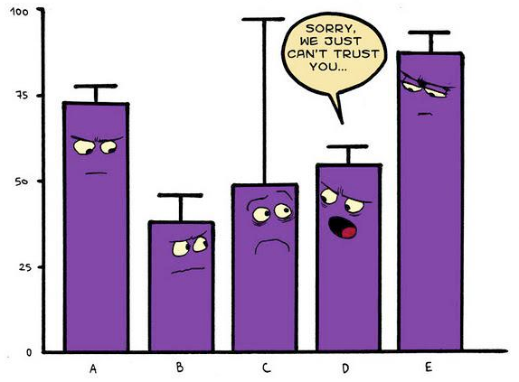
EDA (exploratory data analysis)
2 Slides Max!
Explore, understand, get insights!
Use Visualizations!

Slide 8
Handling data problems
1 Slide Max!
What are you cleaning/Handling?
Missing Values? Outliers?

Slide 9
2.2 Model selection

Slide 10
Model selection
4 Slides Max!
What did you test? ML models? Classical models? Feature engineering and hyper-parameter tunning?

Slide 11
2.3 Results and discussion

Slide 12
Results and discussion
3 Slides Max!
What is your final model? How good is it?
How do you interpet them? Were you able to improve your model given your interpretaions? Was it better than the baseline?

Slide 13
3. Future Work

Slide 14
Future work
1 Slides Max!
What Would you do differently next time?
what would you do if you had more time?

Slide 15
The End!

Slide 16
Pun!

